Slide 1
HMH Science Dimensions
Biology
Unit 8: Evidence for Evolution
Notes:
The learning experiences in this unit prepare students for the mastery of
Performance Expectations
LS4-1 Communicate scientific information that common ancestry and biological evolution are supported by multiple lines of empirical evidence.
LS4-2 Construct an explanation based on evidence that the process of evolution primarily results from four factors: (1) the potential for a species to increase in number, (2) the heritable genetic variation of individuals in a species due to mutation and sexual reproduction, (3) competition for limited resources, and (4) the proliferation of those organisms that are better able to survive and reproduce in the environment.
LS4-3 Apply concepts of statistics and probability to support explanations that organisms with an advantageous heritable trait tend to increase in proportion to organisms lacking this trait.

Slide 2

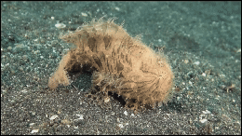
Evidence for Evolution
Unit 8
Many species develop unique features that help them survive.

Slide 3

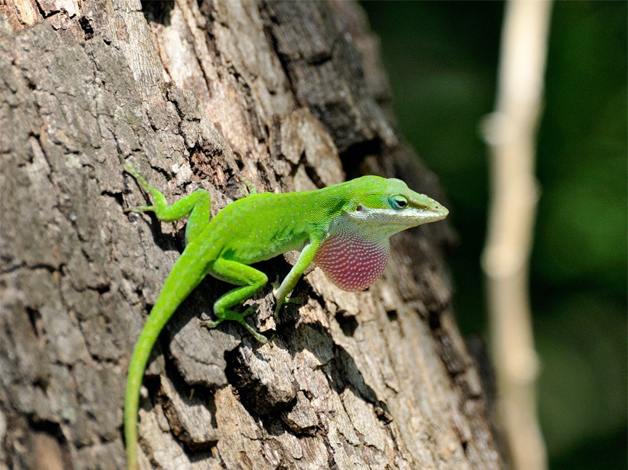

Evidence for Evolution
Unit 8
How do you think species change over time to adjust to varying conditions?
Over the course of 20 generations, some green anoles have developed stickier feet that allow them to survive better in habitats invaded by the brown anole.

Slide 4
Driving Questions
Unit 8
As you move through the unit, gather evidence to help you answer the following questions:
1. How do we know living things have changed over time?
2. What are the mechanisms of natural selection, and how do they lead to changes in species over time?
3. How can environmental changes impact traits in a population?

Slide 5

Unit Project
Unit 8
Investigating the Evolution of Eyes
How can you explain the evolution of eyes?

Slide 6
Unit Review
Unit 8
Synthesize the Unit
Make a concept map, other graphic organizer, or outline using the Study Guides you made for each lesson in this unit. Be sure to use evidence to support your claims.
When synthesizing individual information, remember to follow these general steps:
Find the central idea of each piece of information.
Think about the relationships among the central ideas.
Combine the ideas to come up with a new understanding.

Slide 7
Image Credits
Unit 8
frogfish walking video ©Dive-Videos/Shutterstock; green anole ©Kenneth Jones/Alamy Images

